Slide 1
Lending Club Loans: Predicting the probability of default
by Pat O’Byrne

Slide 2
Overview
Introduction
Exploratory Analysis
The Model
Prediction of Default
Conclusion
Next Steps

Slide 3
Introduction
In 2015, Lending Club, a peer-to-peer lending company had a default rate of 7%, which meant that 7% of loans were not paid back to the investors. The objective of this project is to determine the most influential attributes to the success of a loan and use this combination of attributes to determine the probability of a given loan defaulting.
If Lending Club can reduce the risk of loans being offered, the loans will be more attractive to investors and hence, can increase the overall investment in Lending Club.
The main data set to be used was obtained from the Lending Club site and describes circa 42,000 loans issued between 2007 and 2011.

Slide 4
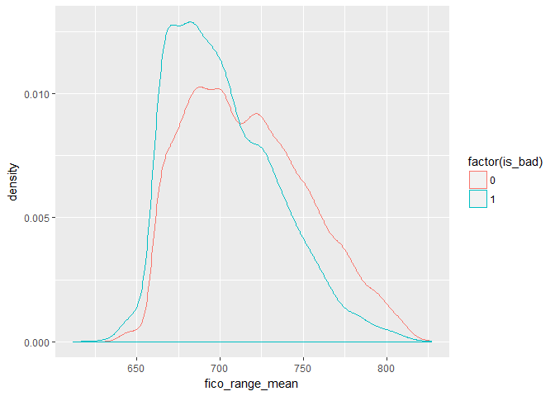
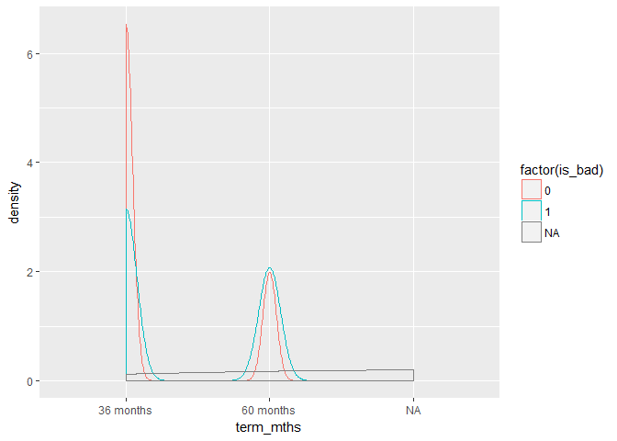
Exploratory Analysis
The loan status (good=0 or bad=1) was compared for each loan across the main loan attributes which quickly showed if a correlation was evident.
FICO score and loan term show a stark difference between the loan status’ – hence, both attributes have an impact on the success of the loan.

Slide 5
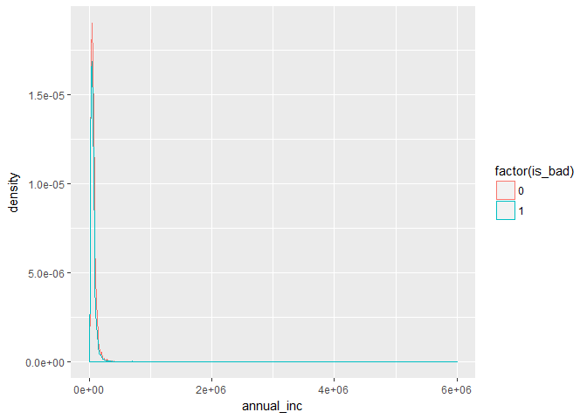
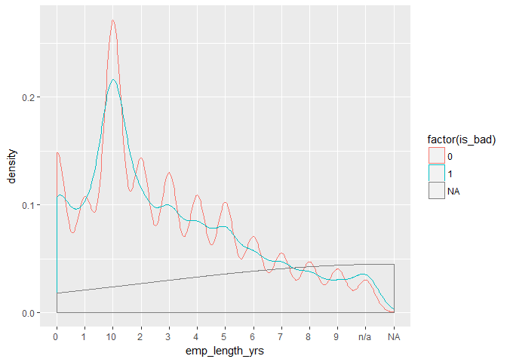
Exploratory Analysis
Annual income and employment length do not appear to have an influence on the loan status – both attributes are similar shape on the graph.

Slide 6
The Model
A Logistic Regression model was built using the glm() function
The “Train” data set was initially used – this was made up of 80% of the original data set, the other 20% for testing
The “Train_under” data set was used for the final model as this included 50% good loans and 50% bad loans.
All attributes were initially included in the model
The attributes were narrowed down based on their significance until the final model was achieved:
model5 <- glm(is_bad ~ loan_amnt + term_mths + purpose + int_rate_percent + grade + annual_inc + total_acc + last_fico_range_high + meet_cred_pol + fico_norm, data = Train_under, family = "binomial")

Slide 7
Model Accuracy
The accuracy of the model was determined using the following metrics:
1. Overall accuracy = (TN + TP)/N
2. Sensitivity = TP/(TP+FN)
3. Specificity = TN/(TN+FP)

Slide 8
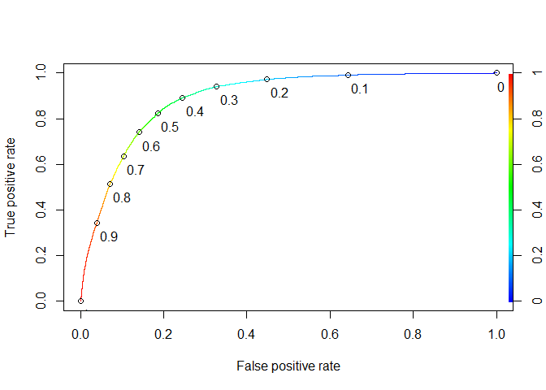
Model Accuracy
Sensitivity is the most important metric for this particular problem and hence the t-value was adjusted to optimal (t=0.35) to achieve a higher sensitivity value. This was done using the ROC curve.
ROCRpred = ROCR::prediction(predict1, Train$is_bad)
ROCRperf = ROCR::performance(ROCRpred, "tpr", "fpr")
p2 <- plot(ROCRperf, colorize = TRUE, print.cutoffs.at=seq(0,1,by=0.1), text.adj = c(-0.2, 1.7))

Slide 9
Results
The predicted risk of default for each loan was determined:
Train$predicted.risk <- predict(model6, type = "response", newdata = Train)
This value allowed for further calculations on the loans to be made:
1. ERR = (1-predicted.risk)*((int_rate_percent)/100) + (predicted.risk)*(-1))
2. Profit = ERR*loan_amnt
3. Amount_Returned = (1+ERR)*(loan_amnt)

Slide 10
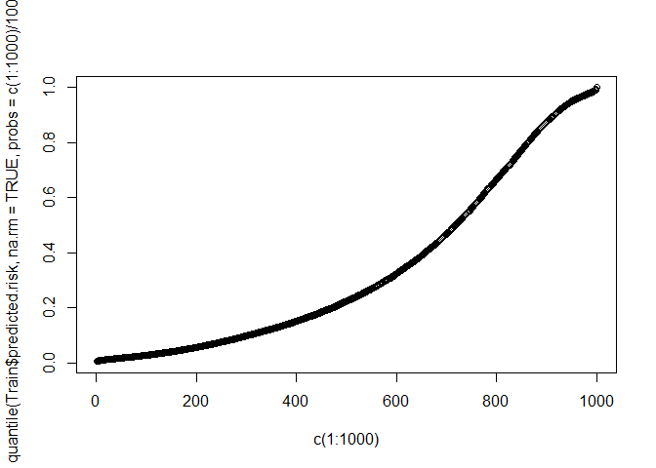
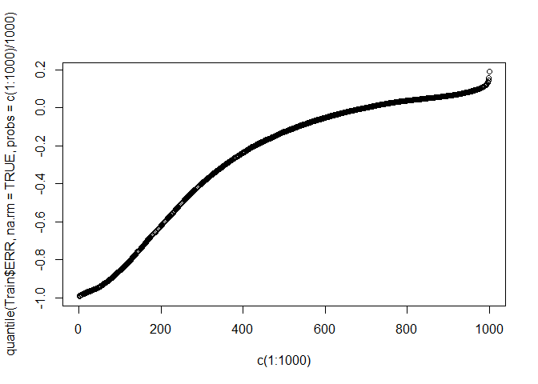
Results
Looking at the quantile distributions for the predicted risk and the ERR
A t-value of 0.35 corresponds to 62% i.e. 62% of loans have a predicted risk below the cut off value of 0.35.
The ERR is predicted as negative for the first 69% of loans which means that there will be an overall loss for the worst 69% of accepted loans. Hence, in order to maximise the profit, 100% of loans should be accepted.

Slide 11
Conclusion
The model which has been built for predicting the probability of default for each loan has been successfully applied to the Lending Club data. The model has outperformed the baseline by 25.7% in terms of accuracy with an optimal sensitivity of 92.5% achieved.
The cost of misclassification of a default loan can be much more detrimental to Lending Club than the cost of misclassification of a successful loan. Hence, it was far more important for the model to keep False Negatives as low as possible rather than False Positives, while still keeping the accuracy high. Hence, a suitable t value was selected to achieve a high Sensitivity.
0.3 < t > 0.5 was determined to be the region of the optimal t-value – which was then selected at t=0.35 using the ROC curve.
62% of the loans were good based on the cut off value of t = 0.35 ie. 62% of loans had predicted risk below 0.35. From this calculation is would appear that Lending Club's screening process may need to be refined in order to keep the predicted loan risk below the cutoff value.
With that said, interestingly, the quantile distribution for the ERR (Expected Rate of Return) tells a different story. 62% of the accepted loans result in a rate of return of -3.9%. Whereas if 100% of the loans are accepted, the overall rate of return is 18.9%.
Taking these two variables into account, it is clear there is a trade-off between the ERR and the Predicted Risk. Hence, it depends on the criteria of Lending Club: to make as much profit overall, or to ensure fewer defaults for the individual investors.

Slide 12
Recommendations
1. Interest rate
In terms of the accepted loan data which was used for the purpose of this analysis, the interest rate plays a significant role in both the loan attractiveness to potential investors (i.e. how much profit can be made on a successful loan) and to the probability of default. This is mainly because it is calculated from other variables that describe an applicants credit history such as FICO score.
Hence, it would be interesting to analyse the interest rate and build a model to determine the main variables that impact the calculation of interest rate. This could then be compared to model 6 used in this project, to see how the interest rate impacts the overall probability of default and to determine if the interest rate can be refined in any way.
2. Rejected data
The rejected data was wrangled in the early stages of the project and combined with common factors in the accepted data. It would be interesting to compare the 2 data sets to build a model that describes the acceptance criteria of a loan. The expectation would be to refine the acceptance criteria and improve the overall probability of default of the accepted loans.
This would be done by removing the worst loans from the approved loan data set and adding in better loans from the rejected loan data set that meet the refined acceptance criteria from the model.

